Slide 1
a-t-l-a-s, atlas!
precog graphs task
by Siddharth Mago

Slide 2
Dataset creation
Sources –
Countries - [Britannica List of Countries](https://www.britannica.com/topic/list-of-countries-1993160)
Cities - [World Population Review](https://worldpopulationreview.com/cities)
Stored in the form of a text file with each place in a new line
The text file is read and parsed to give lists of countries and cities respectively. The combined list is then made by combining the two lists.

Slide 3
TASK 1 – GRAPH ANALYSIS

Slide 4
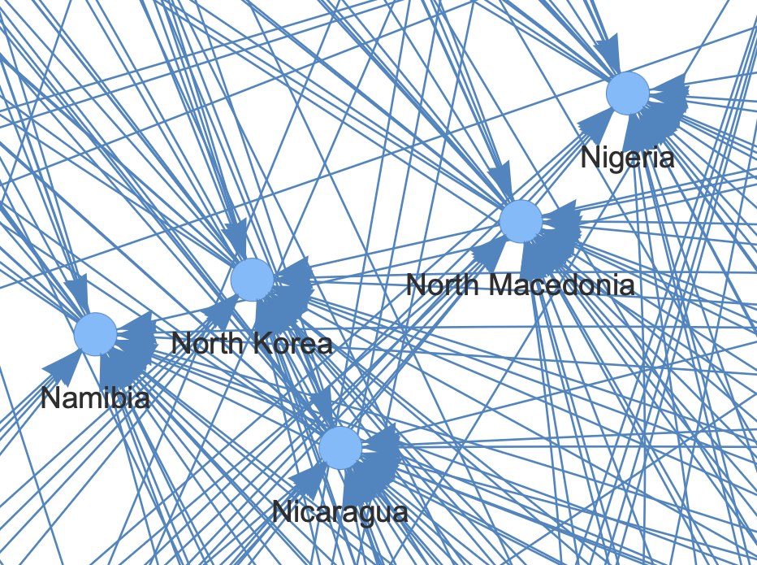
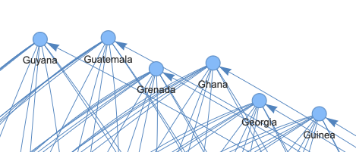
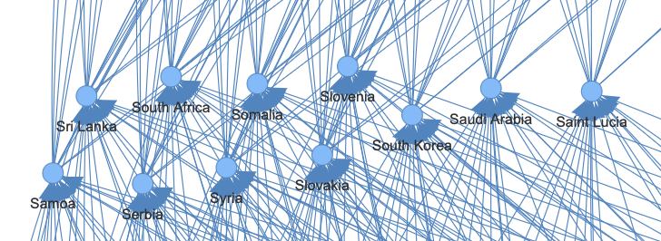
Clustering / Grouping
Places whose names started and ended with the same alphabet (e.g., started with 'g' and ended with 'a') were automatically grouped together.
This happens because these nodes have identical incoming and outgoing edges. Nodes that start with 'x' will have incoming edges from all places ending with 'x', and places that end with 'x' will have outgoing edges to all places starting with 'x’. For stability of graph, the graphs automatically get grouped.

Slide 5
Another observation regarding grouping was that places ending with the same letter but having different starting letters were grouped together more frequently than places with the same starting letter but different ending letters.
This initially seemed counterintuitive, but it makes sense given that edges follow the rule A → B, where B starts with the letter A ends with. Places that end with the same letter all receive edges from nodes ending in that letter, forming dense clusters. Conversely, places that start with the same letter are more spread out since they originate from different last letters, making their connections more dispersed.
More formally:
- Nodes ending with the same letter act as sinks with high in-degree, creating high clustering coefficients.
- Nodes starting with the same letter act as sources with diverse outgoing edges, leading to lower connectivity among them.
Clusters of places ending with less common letters (e.g., "W" or "X") are more isolated, meaning a player stuck in this region has fewer options.

Slide 6
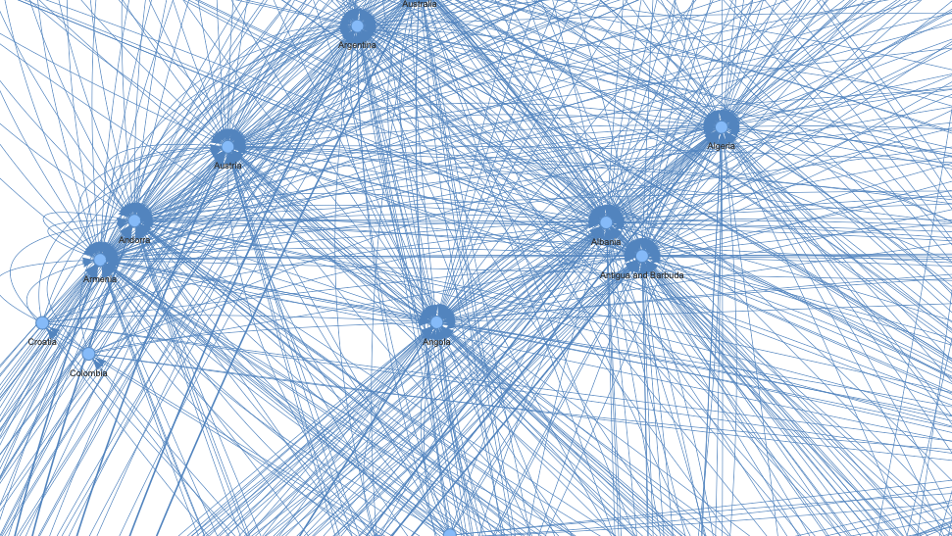
Graph Density
The graph was denser in areas where "popular" nodes were present. Here, "popular" refers to places with a high number of incoming and outgoing edges, typically those that start and end with common letters.
The graph density is higher for cities than countries because cities cover a much wider range of starting and ending letters and also the city graph includes over 3x the datapoints. Following from the statement, the graph density is highest for the graph of the combined dataset.
If a game takes place on a denser graph, it is harder to trap an opponent, since more paths exist.

Slide 7
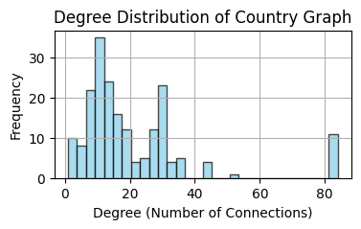
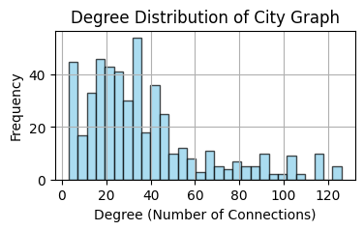
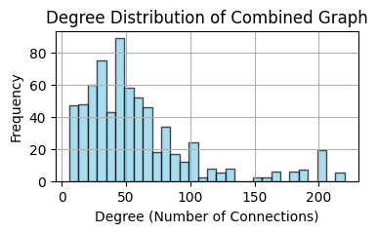

Slide 8
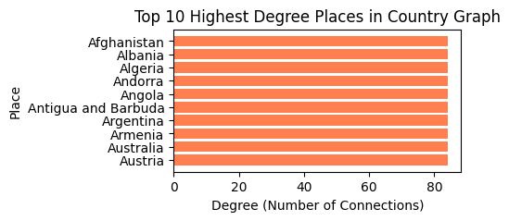
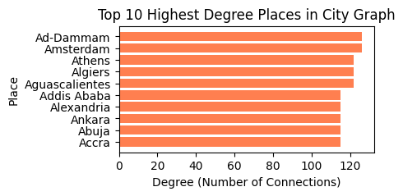
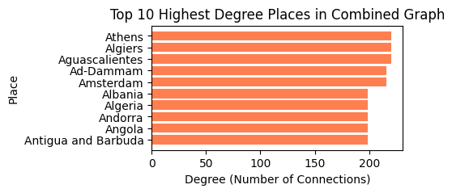
Popular Nodes
A majority of the most popular places in each of the graphs had 'a' as the starting and ending letter which explains why the graph is most dense around nodes beginning and ending with 'a'. However the most popular place in each of the graphs is a country that starts with the letter 'a' but doesn't end with 'a’. Thus we can claim that places starting with the letter 'a' have high clustering coefficients.
High-centrality nodes in the city graph are significantly more interconnected than in the country graph, meaning the game is less predictable when played with cities. The same can be said for the combined graph.

Slide 9
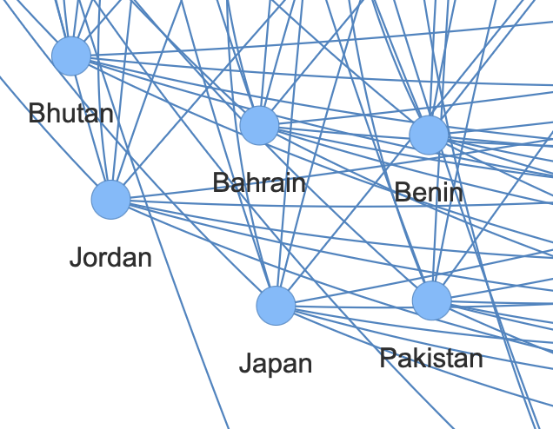
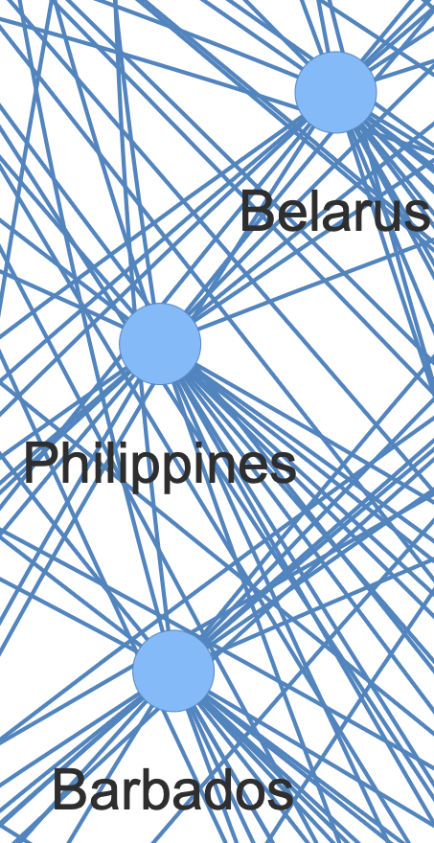
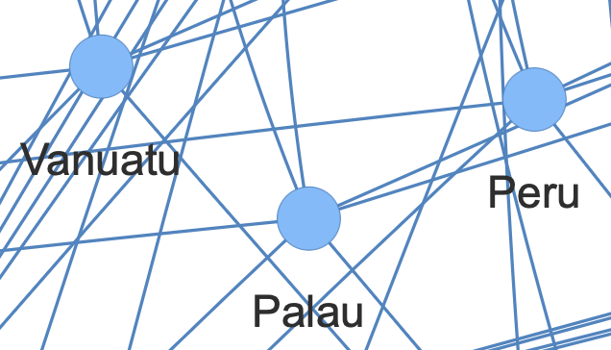
Orphan Nodes
Orphans exist in this graph—nodes representing places with no incoming edges. This happens with countries that start with letters 'b', 'p', 'v', ‘f’, etc., as no country names end with these letters. The number of orphans decreases as we move from country → city → combined graph, since more nodes provide more incoming edges.
These places will never be used in our game. Irrelevant ahh places.

Slide 10
Dead Ends
Dead ends are nodes with no incoming edges. None of our graphs have dead ends from the start, there is no place/node that has only incoming edges. Dead-end probability increases in the country graph and decreases in the city graph and is least in the combined graph since a larger dataset allows for more transitions.
However, certain notable cases exist. In the country graph,
Hungary and Germany each had only 1 outgoing edge, which is directed to Yemen.
Iraq has many incoming edges but only 1 outgoing edge, directed to Qatar.
Given historical trends, it's only a matter of time before these outgoing edge countries truly live up to the term dead-end (emphasis on dead and end) once the US inevitably swoops in to "liberate" some more oil and destabilize the Middle East in the name of freedom™ (RAAAHHHH! WHAT THE HELL IS A KILOMETER?!).

Slide 11
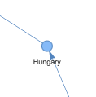
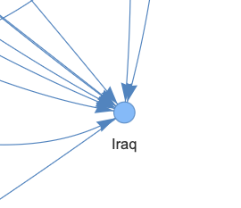
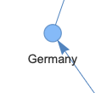
Dead Ends are probably the most important nodes in the graph with respect to the game of atlas where one cannot repeat places. This implies that the number of orphans and dead ends are only bound to increase as the game continues. Dead Ends are important as it is a direct win condition, as there are no outgoing edges the opponent has no possible moves and loses automatically.

Slide 12
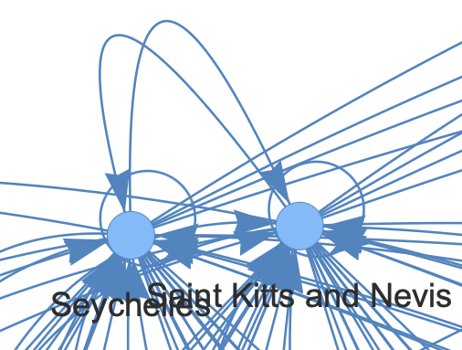
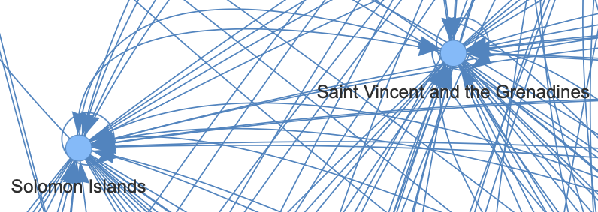
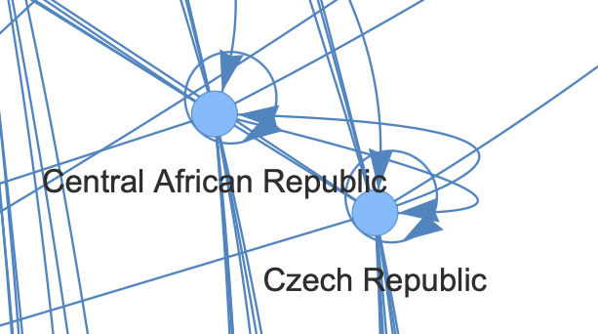
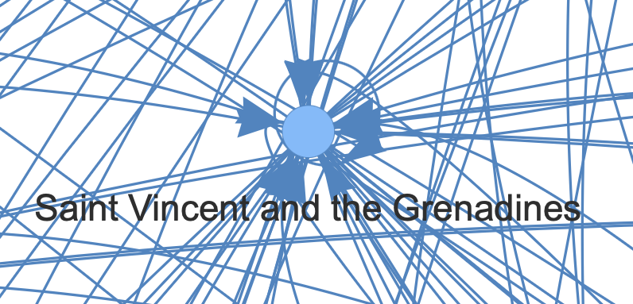
Self Loops
Places that start and end with the same alphabet form self loops - an edge that starts and ends at the same node.
Not of much significance to the game since places can't be repeated but was an interesting find.

Slide 13
Graph Diameter
Graph diameter is defined as the longest shortest path between any two nodes of a graph.
The graph diameter for the graphs are as follows:
Diameter of Country Graph: 7
Start Node: Iraq
End Node: The Bahamas
Longest Shortest Path: Iraq → Qatar → Republic of the Congo → Oman → Nauru → Ukraine → Egypt → The Bahamas
Diameter of City Graph: 6
Start Node: Ouagadougou
End Node: Xi-an
Longest Shortest Path: Ouagadougou → Urumqi → Istanbul → Luoyang → Gaziantep → Phoenix → Xi-an
Diameter of Combined Graph: 5
Start Node: Nauru
End Node: Xi-an
Longest Shortest Path: Nauru → Uganda → Anyang → Gaziantep → Phoenix → Xi-an
A small diameter means the game reaches a trap quickly, while a large diameter means the game can go on for many turns.
The graph diameter reduces with graph complexity because a more complex graph will have more connections between its nodes, allowing for shorter paths between any two points, thus reducing the diameter.

Slide 14
Longest Acyclic Path
In the country graph, longest acyclic path is shorter due to fewer countries means fewer long chains. In the city graph, longest acyclic path is longer due to more data allows for more extended sequences.
The longest path without cycles helps determine the best strategy for staying in the game the longest. If a player avoids loops and stays on the longest path, they can maximize their number of turns.
Longest Path in Combined Graph: 60 steps
Bangkok → Krasnoyarsk → Karaj → Jinzhou → Uruguay → Yichang → Gaoxiong → Guiyang → Germany → Yancheng Jiangsu → Ulaanbaatar → Raipur → Rabat → Tashkent → Thailand → Dhanbad → Dominican Republic → Czech Republic → Chad → Denmark → Kosovo → Omsk → Kabul → Lucknow → West Yorkshire → Egypt → Thiruvananthapuram → Malappuram → Madagascar → Riyadh → Haiti → Iceland → Damascus → Solomon Islands → Seychelles → Saint Vincent and the Grenadines → Saint Kitts and Nevis → South Korea → Aba → Astana → Antalya → Adana → Agra → Accra → Abuja → Ankara → Alexandria → Addis Ababa → Austria → Australia → Armenia → Argentina → Antigua and Barbuda → Angola → Andorra → Algeria → Albania → Azerbaijan → Nanyang Henan → North Korea → Afghanistan
Longest Path in Country Graph: 25 steps
Kuwait → Thailand → Dominican Republic → Czech Republic → Chad → Djibouti → Israel → Laos → Solomon Islands → Seychelles → Sao Tome and Principe → Egypt → The Bahamas → South Korea → Austria → Australia → Armenia → Argentina → Antigua and Barbuda → Angola → Andorra → Algeria → Albania → Azerbaijan → North Korea → Afghanistan
Longest Path in City Graph: 46 steps
Visakhapatnam → Malappuram → Munich → Hohhot → Tashkent → Thiruvananthapuram → Madrid → Dhanbad → Dar es Salaam → Minsk → Krasnoyarsk → Khartoum → Manchester → Raipur → Riyadh → Harare → Esfahan → Nanyang Henan → Nouakchott → Tianjin → Novosibirsk → Kabul → London → Naples → Seoul → Lagos → Shenyang → Gaoxiong → Guiyang → Guatemala City → Yangon → Nagoya → Aba → Astana → Antalya → Adana → Agra → Accra → Abuja → Ankara → Alexandria → Addis Ababa → Ahmedabad → Dubai → Izmir → Rio de Janeiro → Osaka

Slide 15
Strategies
Dead-Ends are win conditions leaving the opponent with no moves. Always choose a dead-end node when possible.
Minimize the chances of the opponent from trapping you in a dead-end, opt for move that has the least outgoing edges to dead-end nodes.
High out-degree centrality node - Once opted for the node with the least outgoing dead-ends, maximise the number of outgoing moves from that node to lower chance of opponent picking a dead-node. In the case where nodes having no dead-end edges exist, minimize the opponents moves.
Assuming there are multiple paths without dead-ends, check for SCCs to have high survivability chance and good future move options.
Longest acyclic path property can be used to maximise the number of turns that can be played from that node onwards.

Slide 16
TASK 2 – COMMUNITY DETECTION

Slide 17
Girvan Newman (Edge Betweenness Centrality)
How it works – 1. Compute the edge-betweenness centrality for each edge in the graph. Here edge-betweenness is the number of shortest paths between pairs of nodes that pass through it. This can be calculated by performing BFS for each node in the graph. 2. Remove the edge(s) with the highest betweenness score. The removed edge(s) is expected to split the graph into different communities as it has high edge-betweenness. 3. Recalculate the edge betweenness after each removal/iteration of the algorithm. 4. Repeat until graph is split into disconnected components, each of which will form a community.
Why Girvan-Newman performs poorly for these graphs - The graph is too inter-connected - The algorithm works best when there are well-defined communities connected by a few "bridge" edges that however for the created graphs there are no clear bridge edges. Edge-Betweenness Centrality is less effective in highly connected graphs as there are too many possible shortest paths and alternate routes which makes edge-betweenness values become more evenly distributed, making identification of max edges hard.

Slide 18
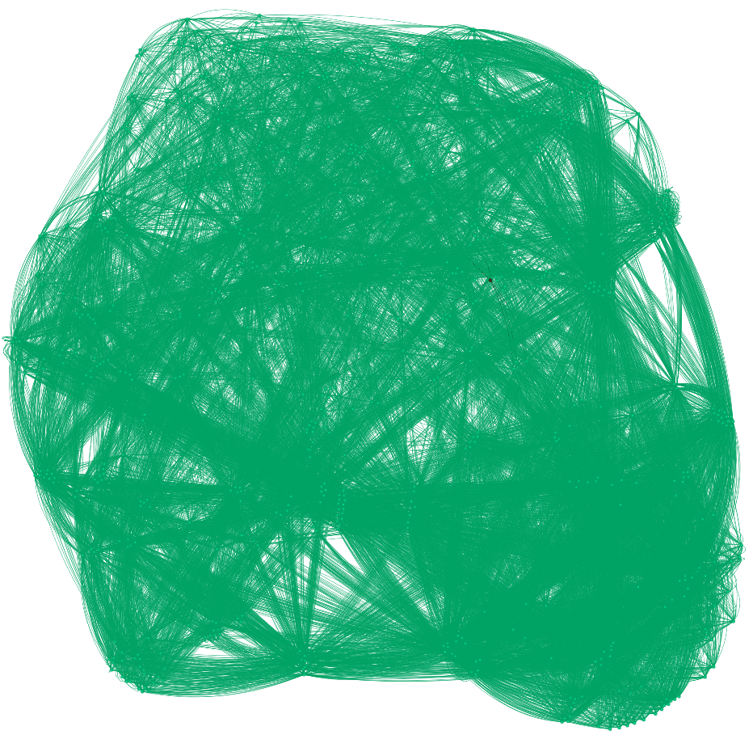
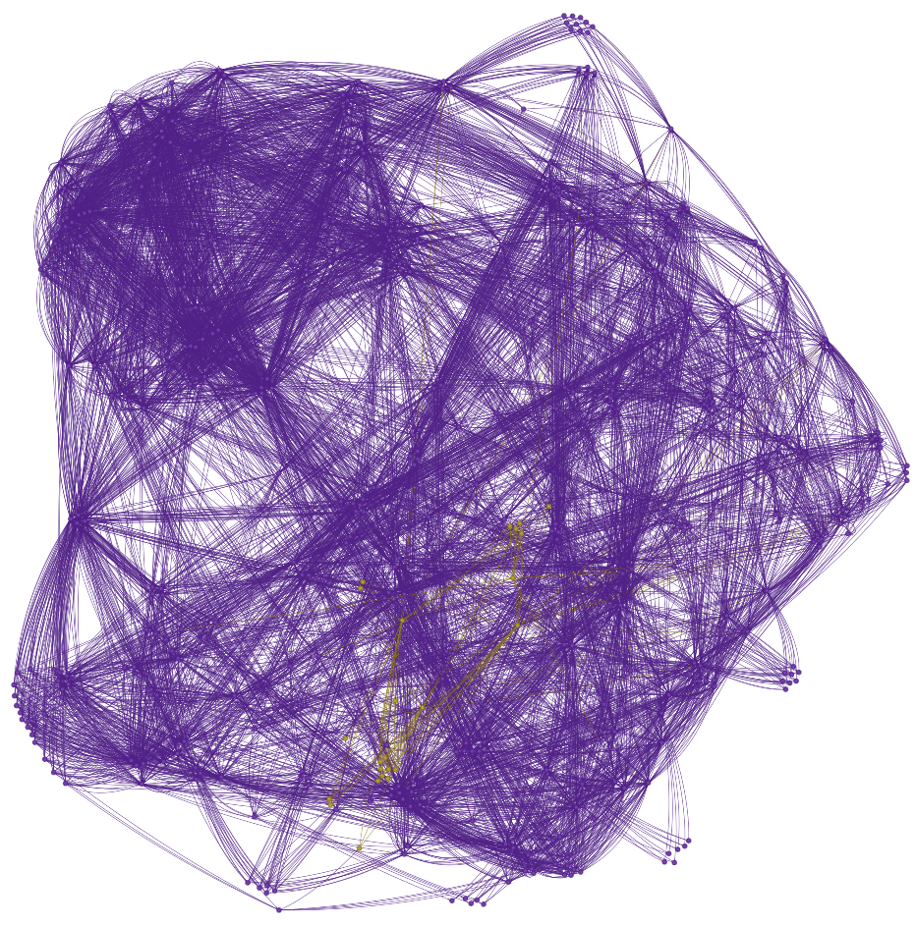
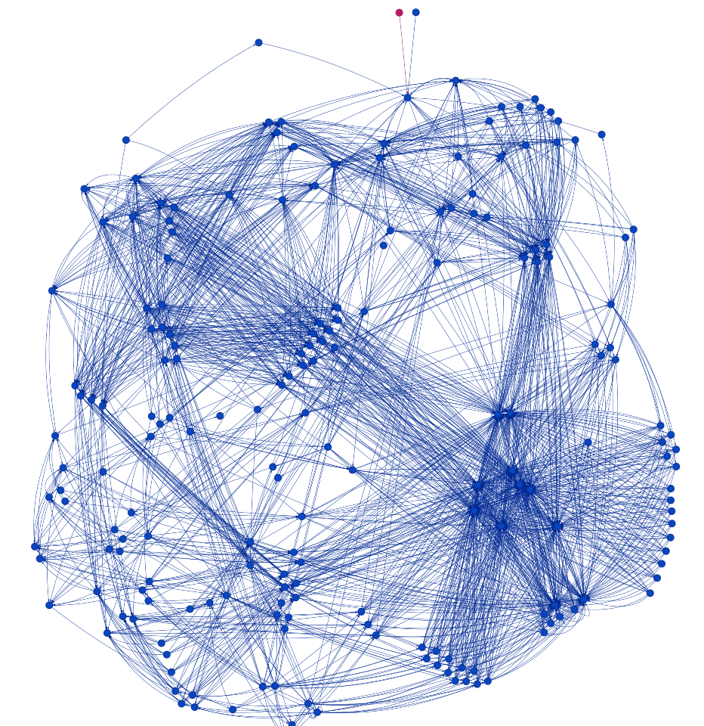

Slide 19
Louvain algorithm
How it works -
1. All nodes are initialised as separate communities.
2. Greedily builds communities by selecting nodes and calculating modularity with every other community. The node is added to the community with the max modularity score.
3. Process is repeated until modularity is maxed out, i.e., there is no improvement in modularity.
4. A new network is built using the communities found and the algorithm is run again to optimize the community detection.
Louvain works better than Girvan Newman due to its greedy approach using modularity, but it still has some drawbacks-
1. Louvain only works for undirected graphs.
2. Moving nodes from one community to another can cause that community to get disconnected which is why, Louvain algorithm has a tendency to discover very weekly connected communities.

Slide 20
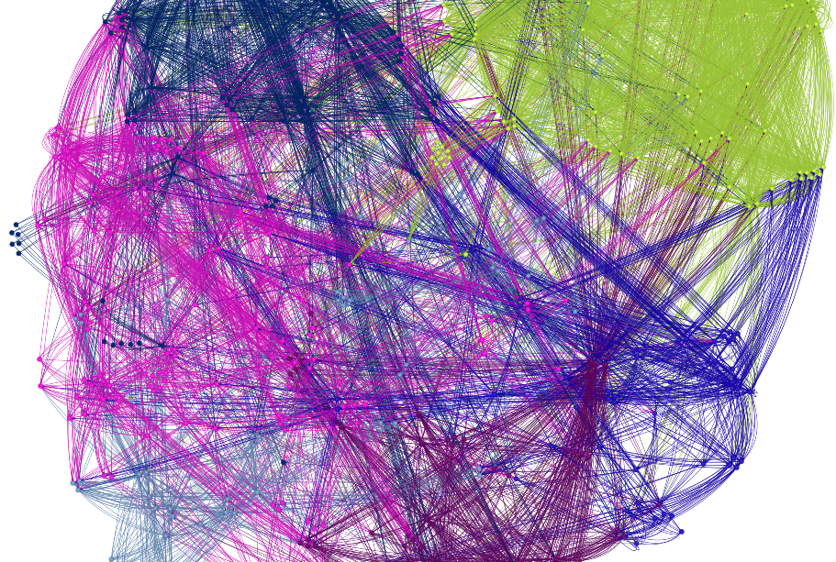
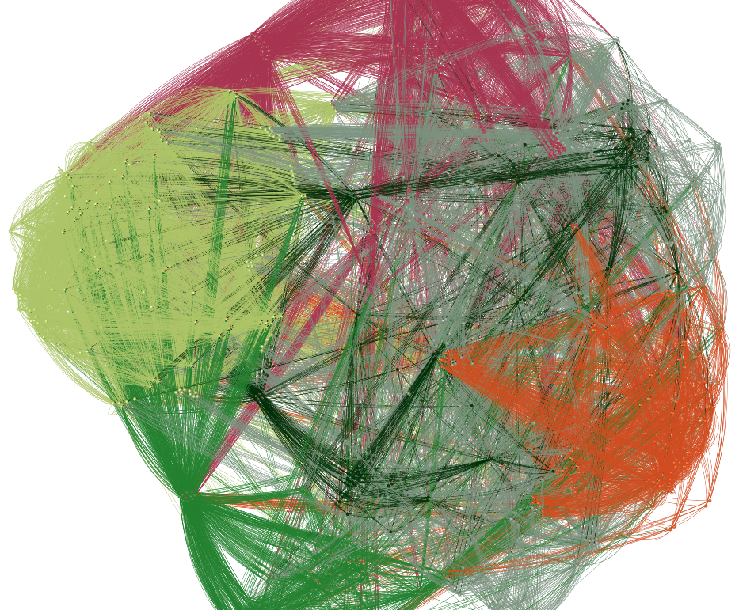
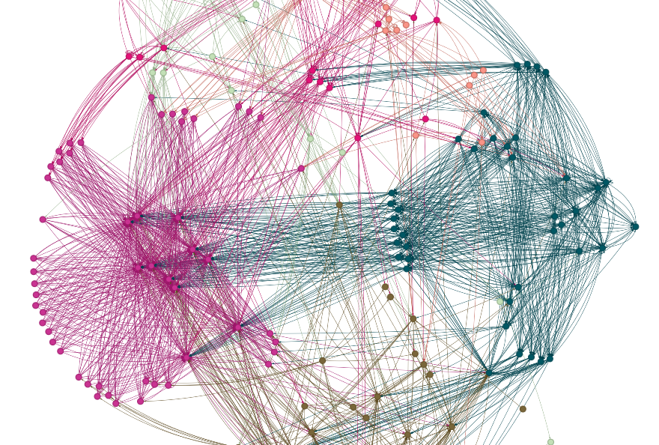

Slide 21
Leiden Algorithm
How it works - Similar to Louvain
1. All nodes are initialised as separate communities.
2. Greedily builds communities by selecting nodes and calculating modularity with every other community. The node is added to the community with the max modularity score.
3. Process is repeated until modularity is maxed out, i.e. , no improvement in modularity.
4. Main difference between Louvain and Leiden - Once the communities are found, they are further split and merged with a randomly chosen community. This is done to increase the quality function (how well the graph is clustered) and because this randomness allows discovering the partition space in more depth.

Slide 22
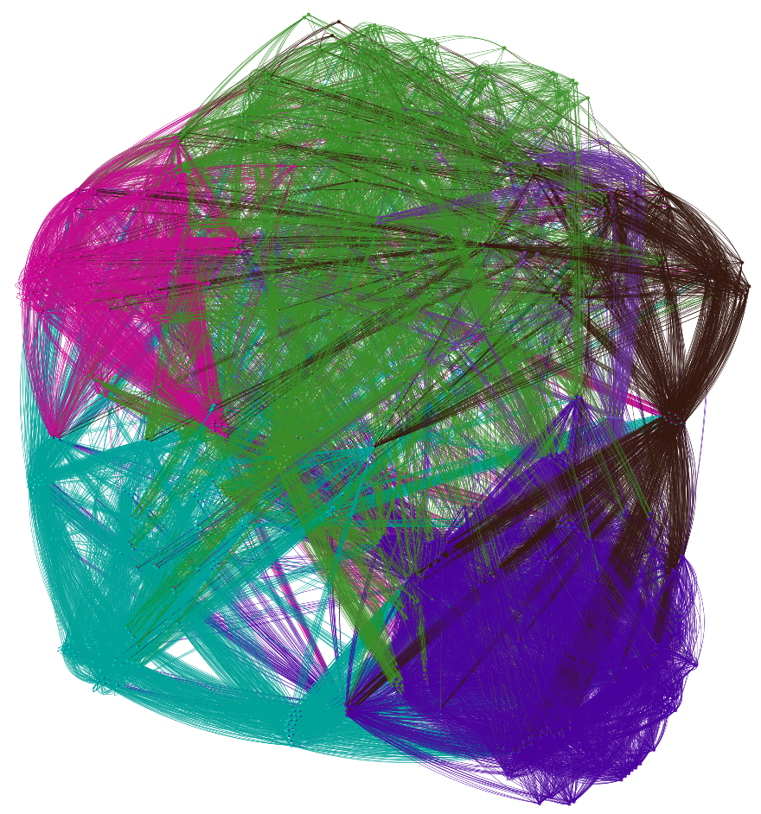
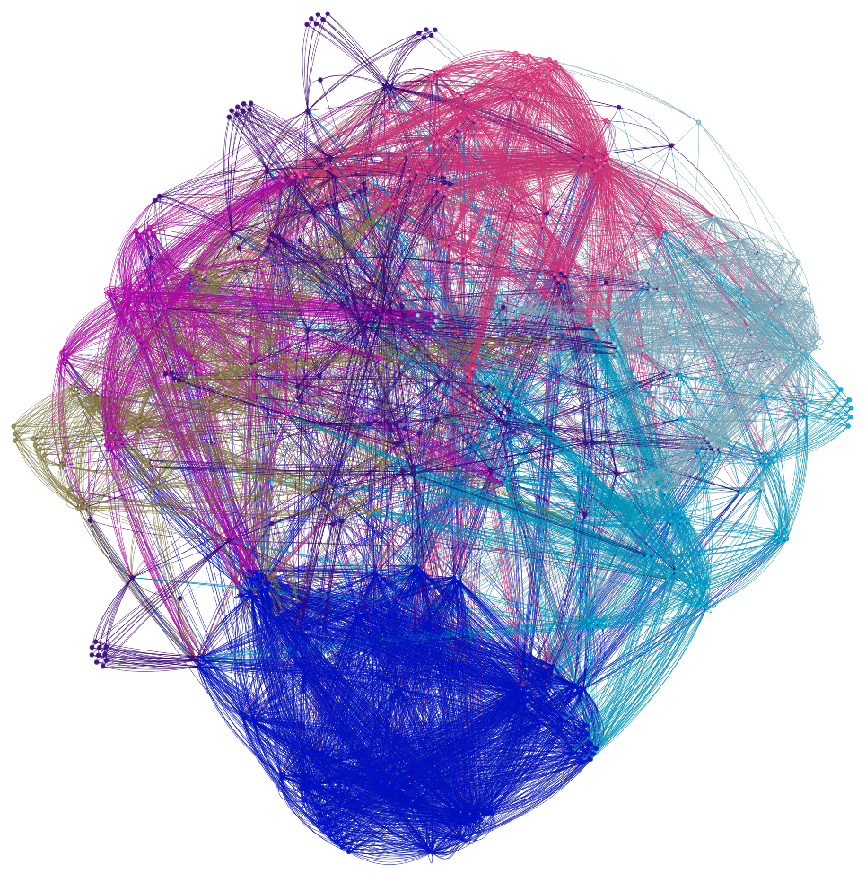
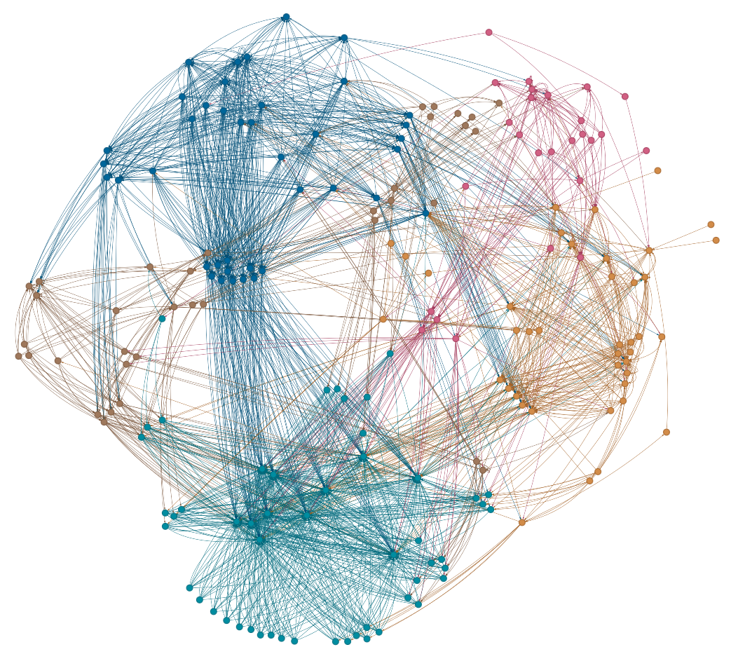

Slide 23
Walktrap Algorithm
How it works - The principle of the algorithm is that random walks on a graph tend to get trapped into densely connected parts which form communities.
1. All nodes are initialised as separate communities.
2. Random short walks are done on the graph and tracked.
3. The algorithm computes how similar two communities are based on how often a random walk moves between them. If some nodes are always visited together/in the same walk they are put in the same community.
4. Communities with highest similarities are merged to form larger communities.
5. The process continues until an optimal set of communities (optimal modularity) is formed.
Why the communities are not as well defined as they are in modularity based community detection -
In highly connected dense graphs, random walks don't stay trapped in local communities but easily jump across multiple communities.
This leads to blurry, overlapping community assignments instead of well-defined structures.

Slide 24
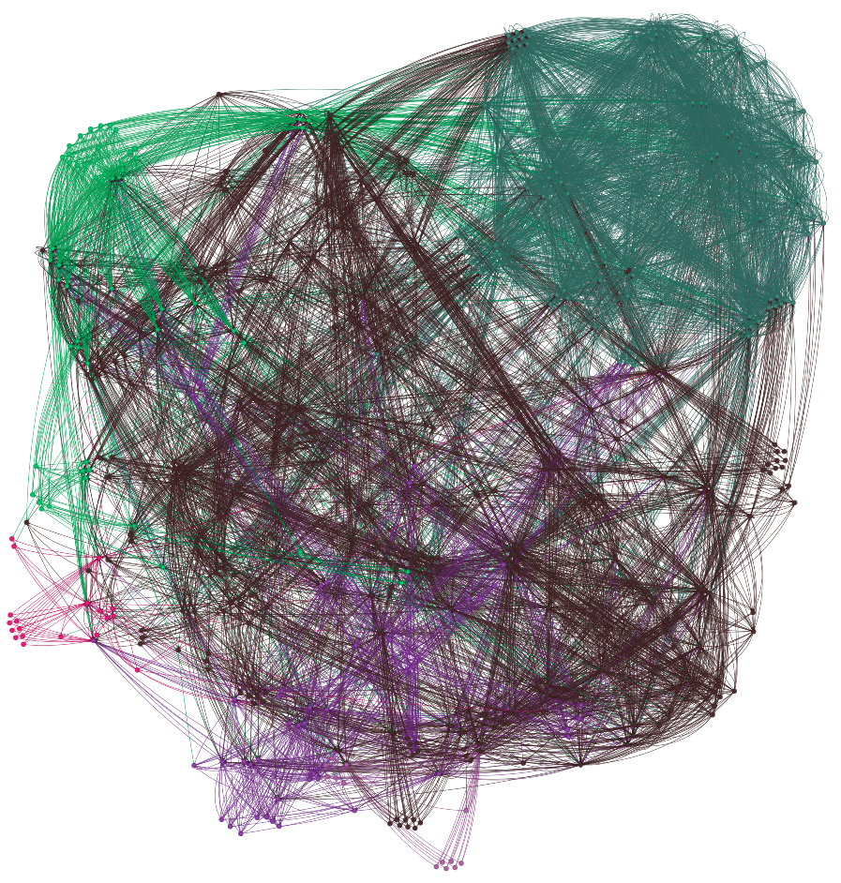
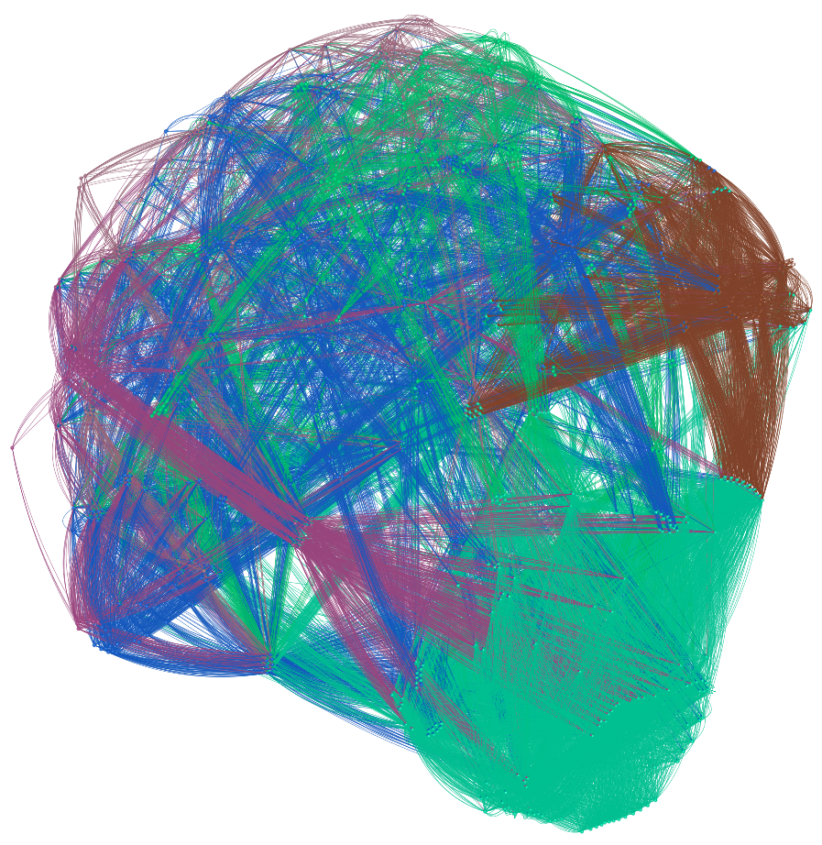
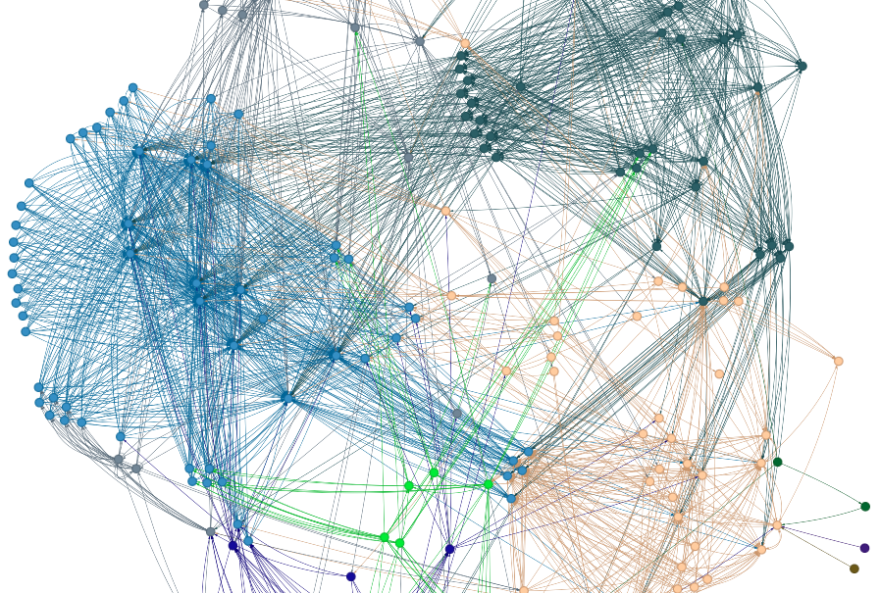

Slide 25
Do the computed communities represent actual concepts or exhibit any patterns that align with human thought?
The computed communities in the country graph are based entirely on the structural connectivity of the graph, which is governed by the last letter–first letter edge connection rule. The countries in a community are related with each other in terms of our connection rule. For all successful community identification algorithms a clear trend is exhibited. These trends can be of the type-
Communities are made of countries all(majority) starting and/or ending with the same letter, i.e., having the same outgoing edges as each other.
Countries starting and ending with ‘a’ ('Albania', 'Algeria', 'Andorra', 'Angola', 'Antigua and Barbuda', 'Argentina', 'Armenia', 'Australia', 'Austria') are grouped together due to the high inter-linking among these nodes.
Countries all ending with the same letter ('Albania', 'Algeria', 'Andorra', 'Angola', 'Antigua and Barbuda', 'Argentina', 'Armenia', 'Australia', 'Austria', 'Azerbaijan', 'Malaysia', 'Malta', 'Mauritania', 'Moldova', 'Mongolia', 'Bolivia', 'Bosnia and Herzegovina', 'Botswana', 'Latvia', 'Liberia', 'Libya', 'Lithuania', 'Bulgaria', 'Cambodia', 'Canada', 'China', 'Colombia', 'Costa Rica', 'Croatia', 'Cuba', 'Kenya', 'Romania', 'Russia', 'Rwanda', 'The Gambia', 'Tanzania', 'Tonga', 'Tunisia', 'Georgia', 'Ghana', 'Grenada', 'Guatemala', 'Guinea', 'Uganda', 'Guyana’) are grouped together due to outgoing edges going to same countries.
Countries starting with the same letter ('North Korea', 'Namibia', 'Nauru', 'Nepal', 'New Zealand', 'Nicaragua', 'Niger', 'Nigeria', 'North Macedonia', 'Norway', 'Bahrain', 'Benin', 'Bhutan', 'Brazil') also get grouped together due to the same sources of incoming edges.
Communities are made of countries that are directly connected to each other by an edge.
('North Korea', 'Namibia', 'Nauru', 'Nepal', 'New Zealand', 'Nicaragua', 'Niger', 'Nigeria', 'North Macedonia', 'Norway', 'Bahrain', 'Benin', 'Bhutan', 'Brazil', 'Lebanon', 'Lesotho', 'Liechtenstein', 'Luxembourg', 'Iran', 'Burkina Faso', 'Oman', 'Cameroon', 'Kazakhstan', 'Kuwait', 'Kyrgyzstan', 'Taiwan', 'Tajikistan', 'Togo', 'Trinidad and Tobago', 'Turkey', 'Turkmenistan', 'Gabon', 'Germany', 'Yemen', 'Uzbekistan', 'Japan', 'Jordan’)
Some Communities act as bridges between other communities, these can be seen in the images as the communities stretching to all parts of the graph with some overlap area with each/some communities

Slide 26
Can We Identify a Strategy Using These Communities?
We can think of countries as nodes in a game, where choosing a name that lies between communities might be a “good” move in terms of connectivity.
Staying in communities with high inter-connectivity (such as communities that have countries starting and ending with the same letter) allowing us to have many possible moves and transitions.
2. Finding Good Transition or “Bridge” Countries
Some countries act as "connectors" between major communities. If a country belongs to multiple different communities in different algorithms, it is likely a bridge between clusters. We can identify such bridge countries by checking which countries frequently change communities across algorithms.
Properties of a strong transition country –
Be in multiple different communities across algorithms → suggests it is a weak boundary.
Have multiple connections to different clusters → suggests it connects diverse regions.
Not be isolated (e.g., Paraguay) → ensures movement is not blocked.
Using this logic, a country like Netherlands, Egypt or Azerbaijan (which appear in different communities across different algorithms) might be a good choice for transitioning between clusters.
3. Strategy for Picking Countries in a Name Game
Pick a country from a high-modularity community to stay within a strong cluster.
Pick a country that appears in multiple communities (bridge countries) to transition to another group.
Avoid isolated countries (e.g., Paraguay, Burkina Faso, Vatican City), as they limit movement.

Slide 27
Algorithm based strategies:
Girvan Newman – highlights weak/isolated countries that can act as bottlenecks/dead-ends throughout the game.
Louvain and Leiden –
Try to start/reach a highly interconnected community
Use bridge countries strategically to switch between different clusters/communities.
Avoid choosing isolated countries (smaller communities) unless they are required for a specific transition.
Walktrap -
Creates smaller, more localized communities, suggesting it favours local connections over global graph structure.
Can be used to better identify paths for movement within a community. While Louvain or Leiden can be used to transition among communities better, the short random walk based implementation can allow walktrap to have better intra-community transitions.

Slide 28
Modularity Assessment
NetworkX Modularity
Girvan-Newman: 0.0 - This score suggests no meaningful community structure was detected, possibly because the method struggled with the graph’s density or size.
Louvain: 0.4616 - A moderately good score, indicating well-separated and internally cohesive communities.
Leiden: 0.4635 - Slightly better than Louvain, showing higher modularity and better optimization of the community structure.
Walktrap: 0.4233 - Slightly lower than Louvain and Leiden but still decent.
cdlib Newman-Girvan Modularity (Adjusts modularity scores for directed edges)
Girvan-Newman: -0.4961 - A negative score implies poor community separation or overlapping clusters. Girvan-Newman tends to perform poorly on larger, dense graphs.
Louvain, Leiden, Walktrap: 0.10 - 0.07 - These scores are very low, suggesting suboptimal performance or issues in how N-G computes modularity.
cdlib Erdos-Renyi Modularity
Girvan-Newman: 0.0097 - Close to zero, indicating random-like community structure.
Louvain: 0.5209 - The best score overall, showing Louvain works well under Erdos-Renyi modularity assumptions.
Leiden: 0.5095 - Close to Louvain, indicating similar high-quality results.
Walktrap: 0.4982 - A slightly lower score but still reflects good community structure.

Slide 29
BONUS – LINK PREDICTION

Slide 30
Goal - to determine if a neural network could learn this underlying linking rule by training on a masked version of the graph.
I implemented both the unsupervised approaches as required by the task:
Node2Vec (using PyTorch Geometric): This method learns node embeddings by performing random walks over the graph and optimizing a skip-gram objective with negative sampling.
2. Graph Neural Network (GNN) – Graph Autoencoder (GAE) with a GCN Encoder: In this approach, I mask a subset of edges from the graph and train a GCN-based encoder to reconstruct the remaining (observed) edges.

Slide 31
Node Feature Creation
I started with a list of country names read from a text file. Using NetworkX, as done for the previous tasks, I built a directed graph where each node represents a country, and an edge is created when the last letter of one country matches the first letter of another.
For node features, I decided to use the simple feature that was provided in the question statement—Just the first and last letter. I stored the normalized ordinal value of the first and last letter of the country name in a 2-dimensional vector for each country.
I chose this node feature because it was the most obvious and in my opinion the whole core of our graph which is made using a rule solely based on these first and last letters, these features directly capture the implementation of the graph. Although more complex features (as stated in the problem statement) could be explored, I opted for this representation to directly reflect the graph’s construction and also to keep the model simple.

Slide 32
Training
Both methods were trained in an unsupervised manner, i.e., they were implemented without explicit edge labels passed along with input data. As described earlier, Node2Vec leverages local graph structure through random walks, while the GAE reconstructs the graph structure from masked edges.
Node2Vec:
The training objective here is to maximize the probability of node co-occurrence in random walks. I used a skip-gram-like objective with negative sampling. The model generates random walks over the graph and optimizes the embeddings such that nodes appearing together in these walks have similar representations. After training, the dot product between node embeddings is used as the link prediction score.
Graph Autoencoder (GAE) with GCN Encoder:
In this approach, I first mask a percentage (20%) of the edges from the original graph. The GAE then uses a two-layer GCN encoder to map nodes into a latent space. The unsupervised training objective is to reconstruct the masked (or training) edges using a reconstruction loss (binary cross-entropy computed on the dot product of node embeddings). This forces the encoder to learn representations that capture the structural information necessary to predict connectivity.

Slide 33
Inexperienced with GNNs, my initial parameters were numbers I picked up from my resource articles. While these parameters were not vetted, the model still performed better than random with the node2vec AUC ~0.628 and GAE AUC ~0.725.
Initially I thought maybe the features aren’t getting enough representation due to the embedding layer and hidden layers being too low, so I increased them in small increments and observed the changes. Increasing embedding layer in node2vec and hidden layer in GAE did have a small positive impact on the respective AUCs but not enough to fully address the limitations imposed by the low-dimensional feature representation so I reverted back to the original layers.
I wanted to study the loss function and how it changes with epochs but 100 epochs was too less and the loss function value did not have a gradual decrease that I could monitor so I continued to tweak the parameters, increasing the epochs to 10x, lowering the learning rate by 0.5x for both node2vec and GAE which boosted the model AUC significantly for the case of node2vec with AUC ~0.778 but remained similar for GAE with AUC ~0.761.
After boosting epochs, I decided to once again test feature representation by increasing the embedding and hidden layers. This caused an improvement in GAE by a good margin but almost no change in node2vec. I lowered the embedding layer for node2vec and increased the hidden layer for GAE.

Slide 34
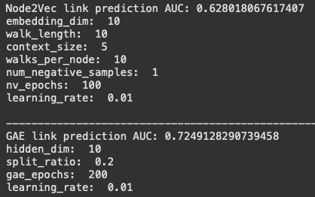
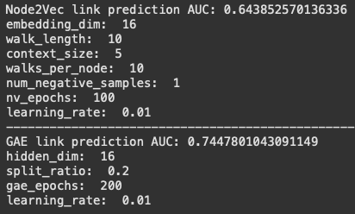
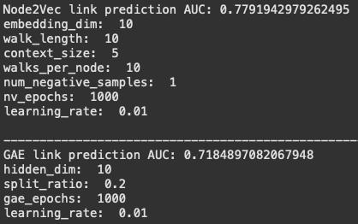
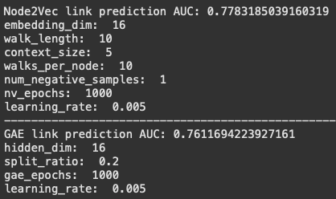
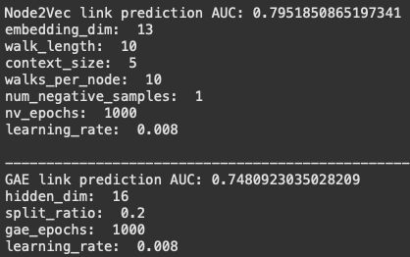
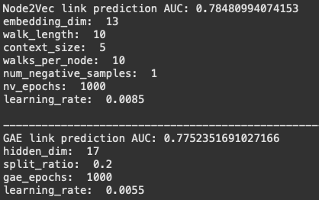

Slide 35
Implementation and Performance
Node2Vec Approach:
• Implementation: I implemented the Node2Vec model using PyTorch Geometric’s built-in functions. Random walks are generated over the graph, and a training loop optimizes the skip-gram loss using negative sampling.
• Performance: After training for 1000 epochs, I evaluated the link prediction performance using ROC AUC on all observed edges versus randomly generated negative edges. The Node2Vec model achieved an AUC of 0.785, indicating that it successfully learned the linking pattern.
GAE (GNN) Approach:
• Implementation:
I used a two-layer GCN as the encoder within a Graph Autoencoder framework. After masking out 20% of the edges, the model was trained to reconstruct the remaining edges.
• Performance:
The GAE was trained for 1000 epochs. Evaluation on the masked (test) edges yielded a ROC AUC of 0.775 demonstrating that the GCN-based embeddings were able to capture sufficient structure for link prediction.
Overall, Both approaches performed better than random (0.5) AUC.

